Slide 1
CSCI-SHU 220: Algorithms
Introduction
Fall 2020 @ NYU Shanghai

Slide 2
Part I: Set Things Up

Slide 3
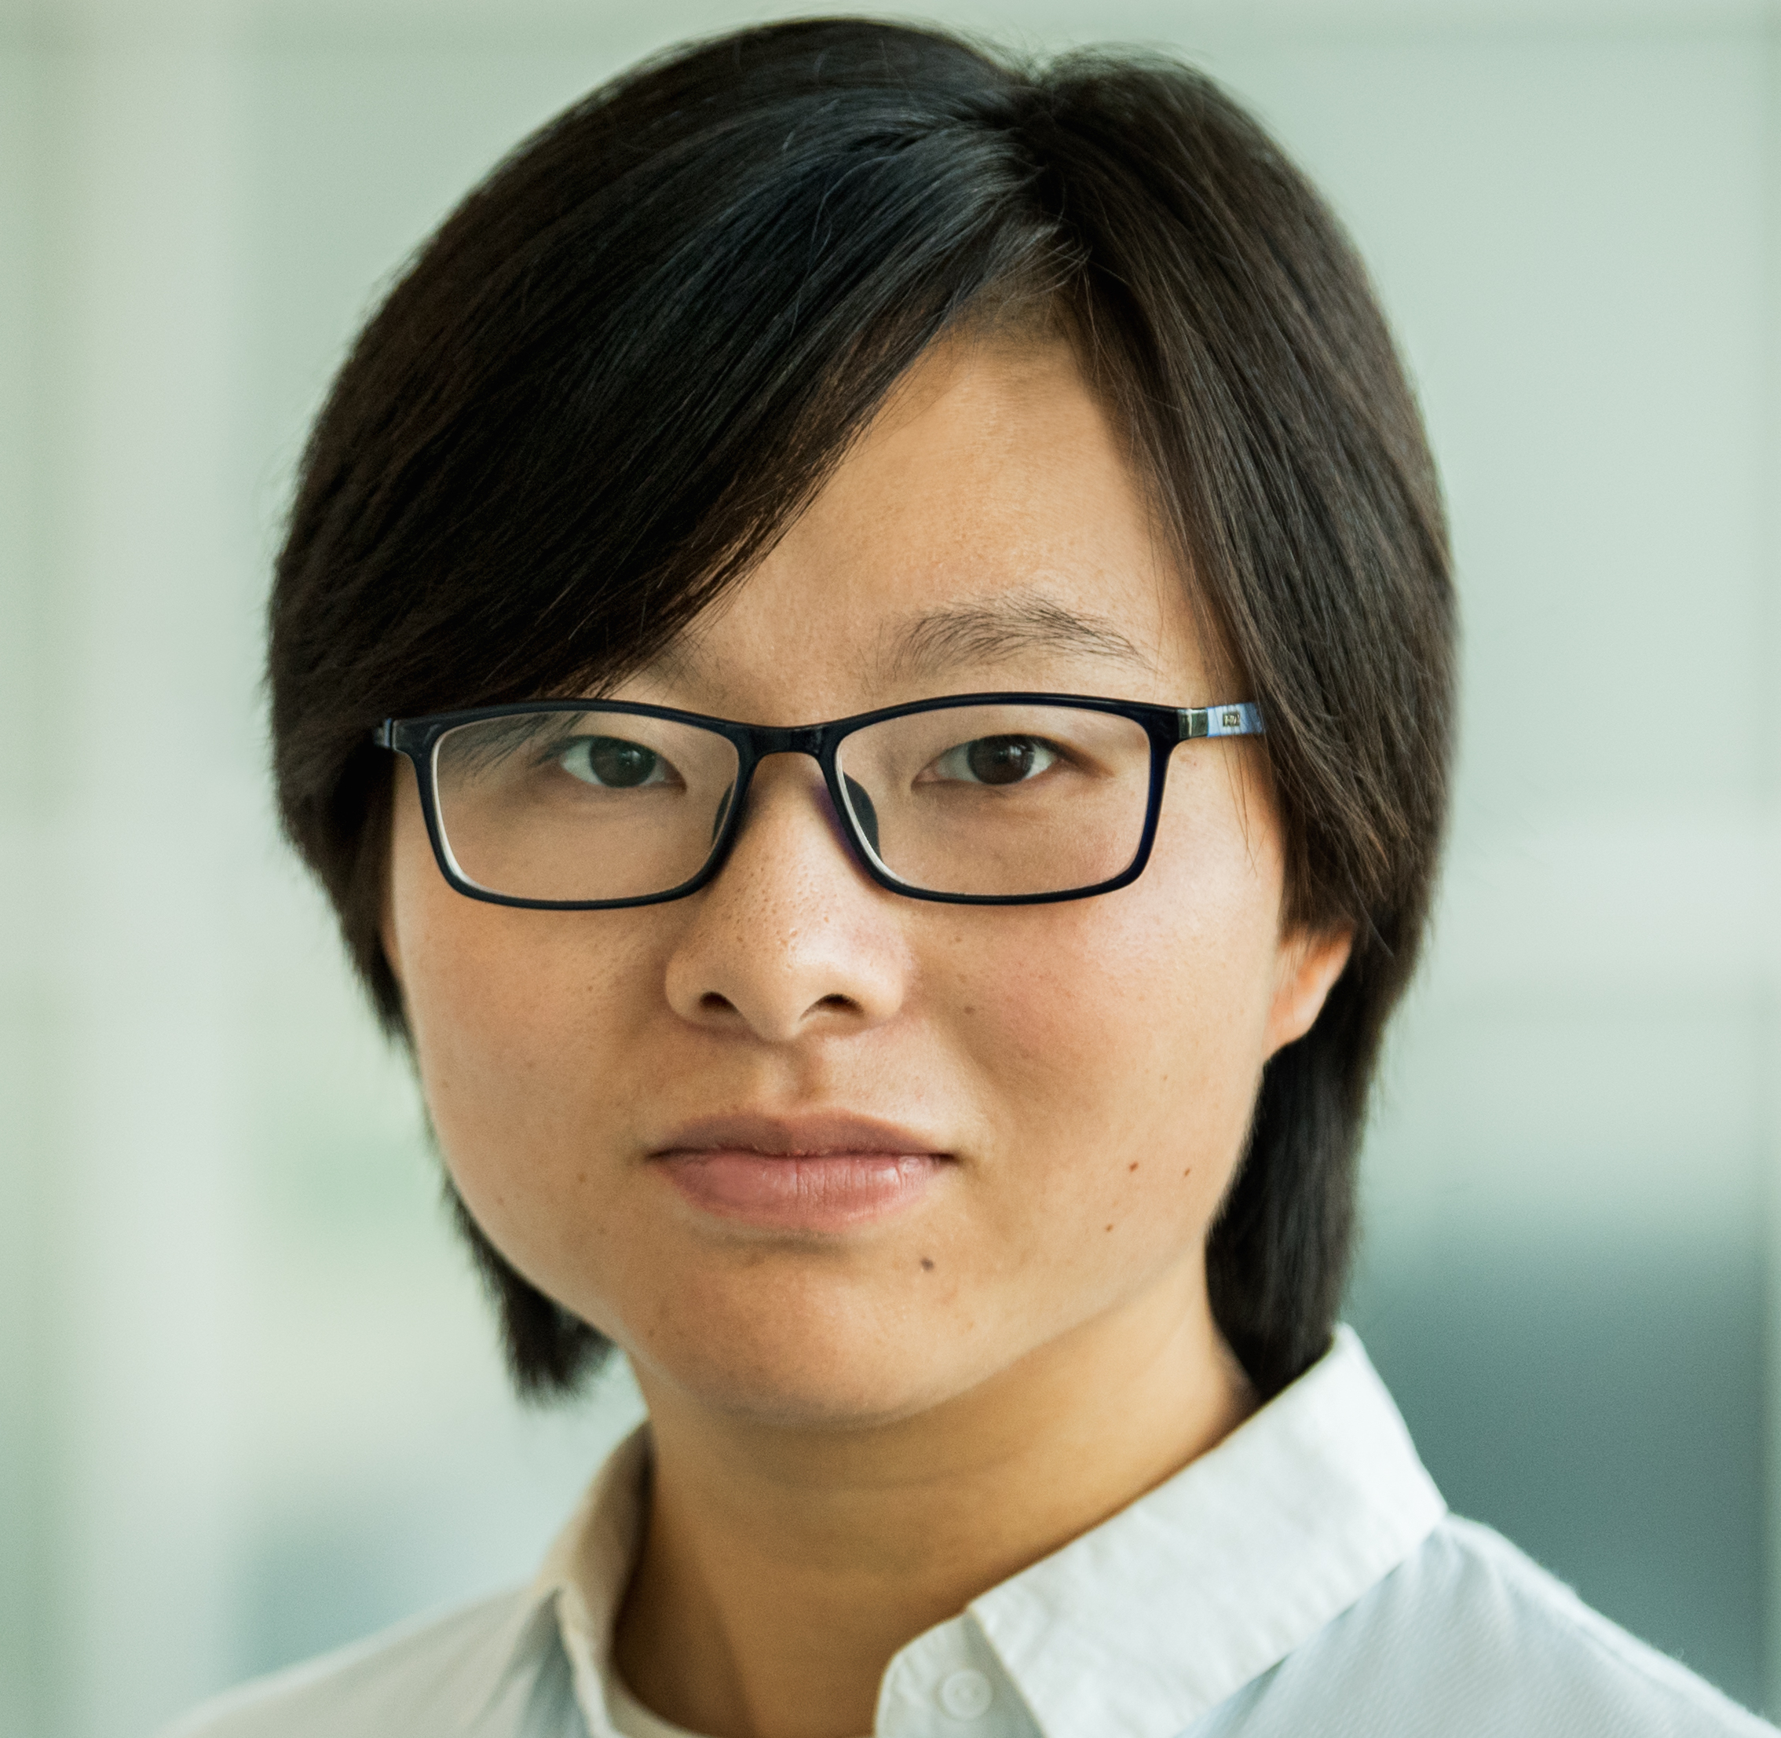
Instructor
Siyao Guo
siyao.guo@nyu.edu

Slide 4

Recitation Instructor
Liangzu Peng
lp2528@nyu.edu
Notes:
Homework related issues: grades, homework solution

Slide 5

Learning Assistant
Jerry (Yuhao) Ding
yd1158@nyu.edu

Slide 6


Slide 7
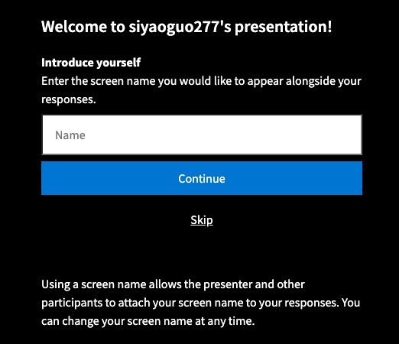
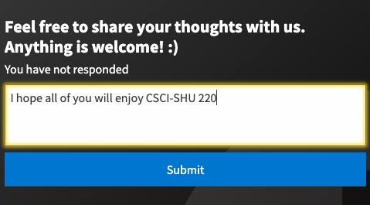
Share Thoughts Anonymously
https://PollEv.com/free_text_polls/Un4kWgw2oJROitk8R2h4A/respond

Slide 8
Seating Assignment
Select your seat today
Report the seat number in the seating assignments tool in NYU classes
Keep the same seat for the entire semester

Slide 9
Part II: Course Overview

Slide 10
Course Information
Meeting time:
Lectures: MW 11:30-12:45p (@604)
Recitations: F 11:30-12:45p (@604)
Office hours: W 2:00-3:00p (Siyao@1159)
F 2:00-3:00p (Liangzu@1162G)
TF 1:00-2:15p (Jerry@ARC)
or by appointment
Grading:
5 Assignments (25%)
1 midterm (25%)
1 final (50%)

Slide 11
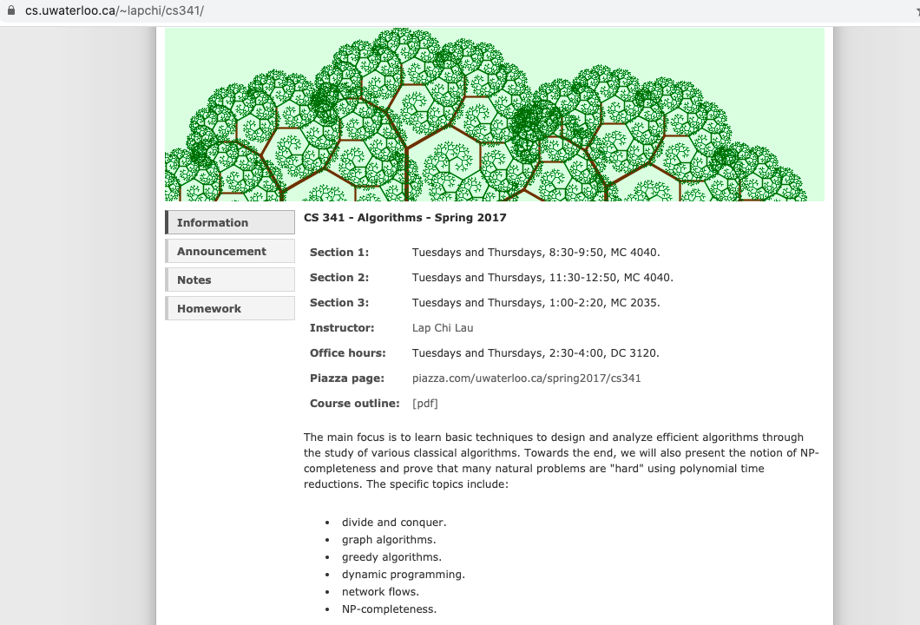
The Main Source

Slide 12
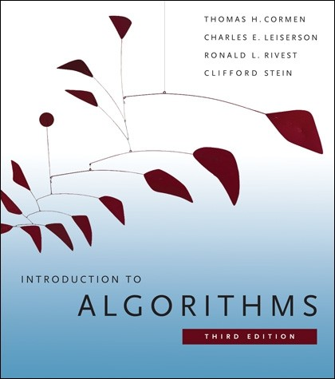
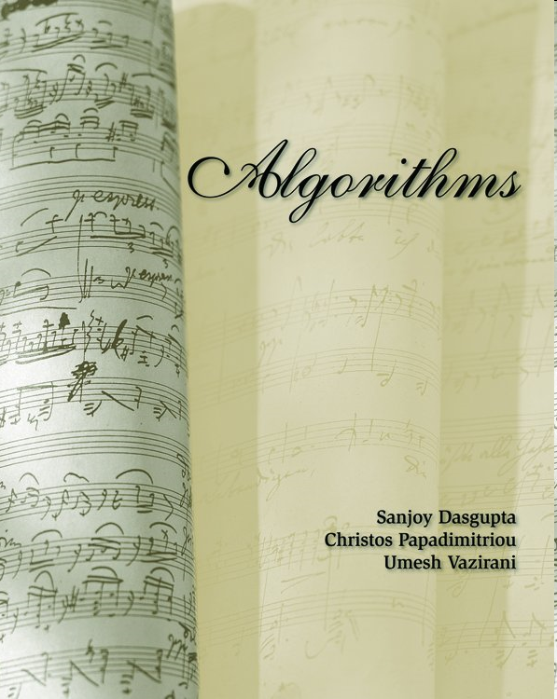

Reference Books
[CLRS]
[DPV]
[KT]
Hard/E-copy: Course Reserves @ NYU Classes

Slide 13
Course Overview
Problem Solving
1. Get to the mathematically clean core of a problem
Our Focus
2. Design and analyze algorithms (correct, efficient)
3. Careful implementation (may use good data structures)
Learn basic techniques through the study of
various classical algorithms

Slide 14
Course Schedule (Tentative)
Week/Date | Topic/Concept
[Week 1] | Introduction and Basics
[Week 2] | Solving Recurrence
[Week 3] | Divide and Conquer
[Week 4] | Sorting
[Week 5] | Greedy Algorithms
[Week 6] | Greedy Algorithms
[Week 7] | Dynamic Programming
[Week 8] | Overview and Midterm Exam
[Week 9] | Dynamic Programming
[Week 10] | Basic Graph Algorithms
[Week 11] | Graph Algorithms
[Week 12] | Graph Algorithms
[Week 13] | NP-Completeness
[Week 14] | NP-Completeness
[Week 15] | Final Exam
Notes:
Week 1-2: Math Foundations
Week 3-12: Basic techniques through the study of various classical algorithms
Week 13-14: Hard problems and beyond

Slide 15
Assignment Due/Exam Schedule
Assignment 1 (up now) : Sep 28
Assignment 2: Oct 16
Mid-term exam: Nov 2
Assignment 3: Nov 6
Assignment 4: Nov 23
Assignment 5: Dec 7
Final exam: Dec 17-22 (TBD)
Notes:
Sep 28, Oct 16, Nov 6, Nov 23, Dec 7
Nov 2

Slide 16
Assignment Policies
Assignments:
Collaboration: allowed, must indicate collaboration.
Search for solutions: considered plagiarism.
Write your own solutions.
Submitting Assignments
Required to typeset solutions (templates will be provided).
Due at 11pm and should be submitted via NYU Classes.
Late assignments are acceptable up to 24 hours after due date with a 25% penalty.

Slide 17
Addressing Concerns
Programming Languages?
Teaching in pseudocode or C/C++
Hw/exams, pseudocode/python is fine
Algorithms in competitive programing?
More advanced algorithms and data structures
More problem modeling skills
Speedy implementation of algorithms
Best practice for studying algorithms?
Practice of problem solving
Even for classical problems, try to solve the problem by yourself

Slide 18
Other Remarks
Academic Integrity
You are expected to comply with NYU’s academic integrity guidelines
http://www.nyu.edu/about/policies-guidelines-compliance/policies-and-guidelines/academic-integrity-for-students-at-nyu.html
Disability Disclosure Statement
Academic accommodations are available
Be registered with Moses Center for Students with Disabilities (mosescsd@nyu.edu)
Contact Cydney Delia (cydney.delia@nyu.edu) for assistance in registering
Need Help? Any comments? Feel free to ping me ☺

Slide 19
General Sharing
Have a good attitude
Develop and value your own perspectives
Grow through collaboration

Slide 20
Any Questions? (about me? the course?)

Slide 21
A Bit More About You? (e.g. names, hobbies, goals/dreams)

Slide 22
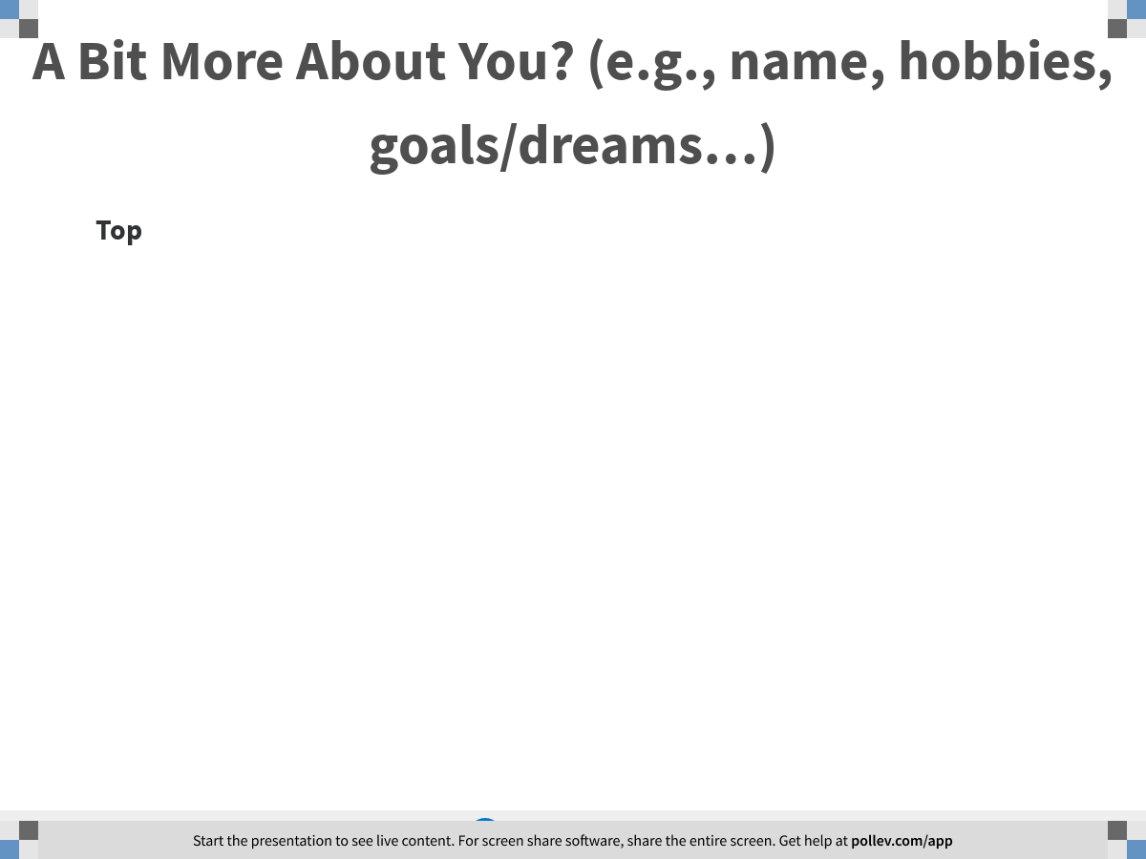
Notes:
A Bit More About You? (e.g., name, hobbies, goals/dreams…)
https://www.polleverywhere.com/discourses/yTmx8J8dlgLYdOCD5sNtq

Slide 23
Part III: A Sample Lecture

Slide 24

Warm Up: A Competition

Slide 25

Notes:
All about Cutting Watermelons
https://www.polleverywhere.com/competitions/ykFTT03M9fL9O9u033QSD?display_state=welcome&controls=none&onscreen=persist

Slide 26
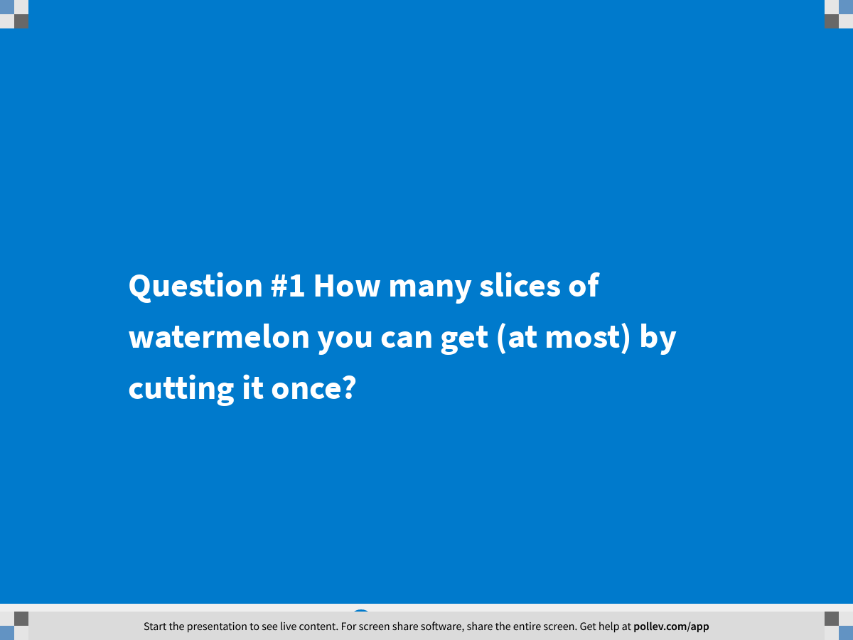
Notes:
Question #1 How many slices of watermelon you can get (at most) by cutting it once?
https://www.polleverywhere.com/multiple_choice_polls/XqWDO1B8q1pxbH4ZmeX2N?display_state=title&controls=none&onscreen=persist

Slide 27
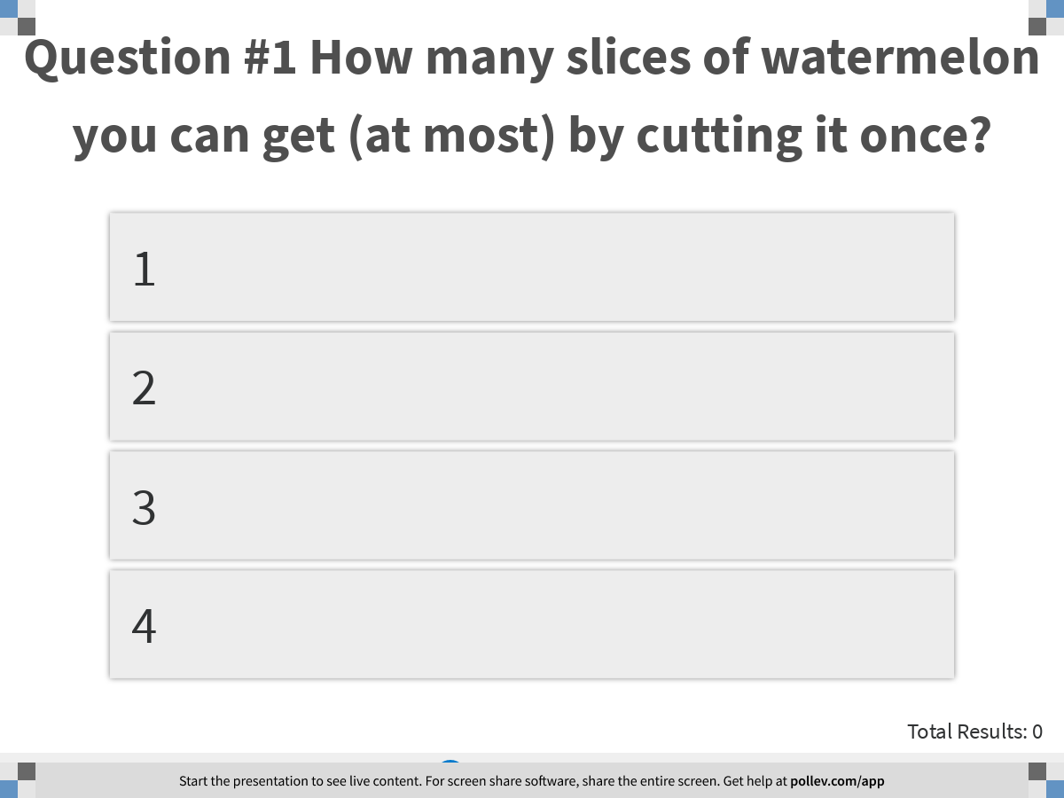
Notes:
Question #1 How many slices of watermelon you can get (at most) by cutting it once?
https://www.polleverywhere.com/multiple_choice_polls/XqWDO1B8q1pxbH4ZmeX2N?display_state=instructions&controls=none&onscreen=persist

Slide 28
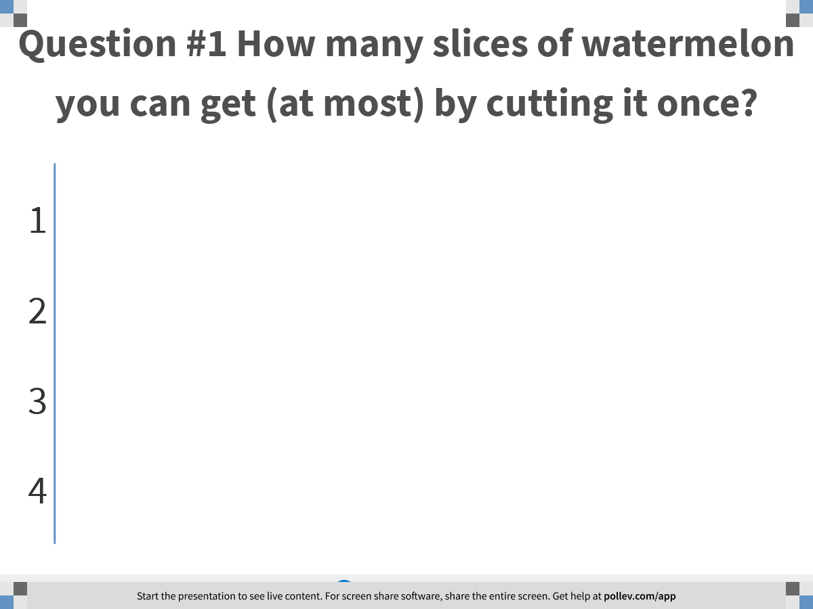
Notes:
Question #1 How many slices of watermelon you can get (at most) by cutting it once?
https://www.polleverywhere.com/multiple_choice_polls/XqWDO1B8q1pxbH4ZmeX2N?display_state=chart&display=correctness&controls=none&onscreen=persist

Slide 29

Notes:
All about Cutting Watermelons
https://www.polleverywhere.com/competitions/ykFTT03M9fL9O9u033QSD?display_state=leaderboard&onscreen=persist

Slide 30
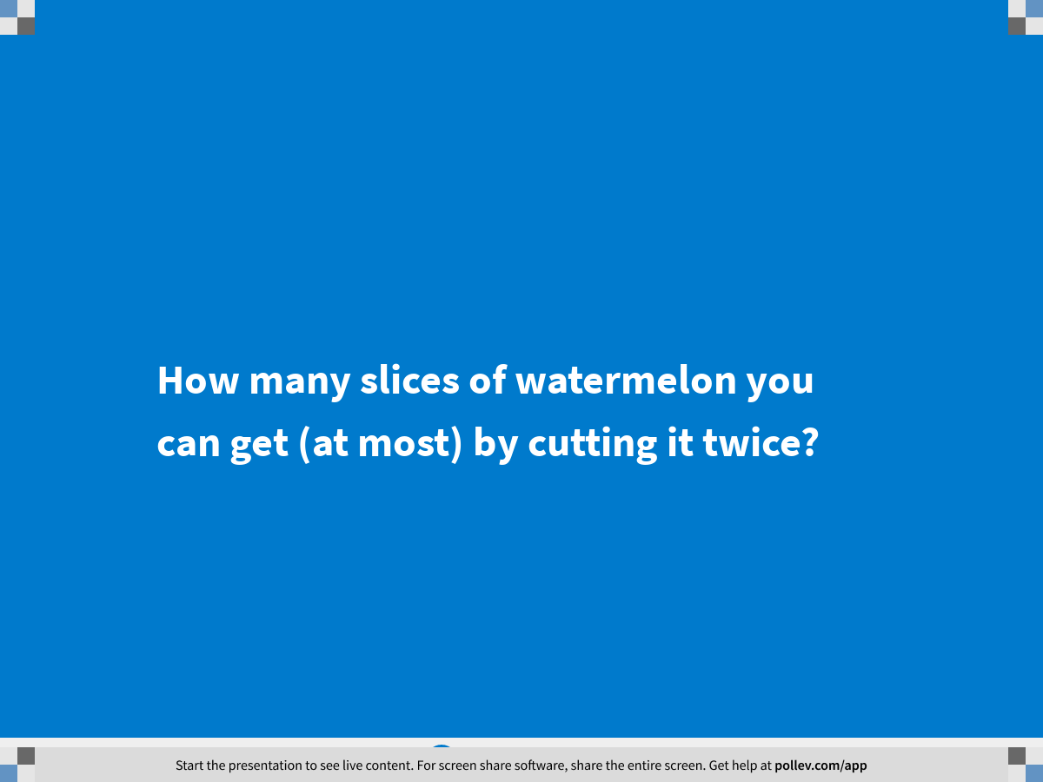
Notes:
How many slices of watermelon you can get (at most) by cutting it twice?
https://www.polleverywhere.com/multiple_choice_polls/986WsbnD4uFYzrQfbJkzu?display_state=title&controls=none&onscreen=persist

Slide 31
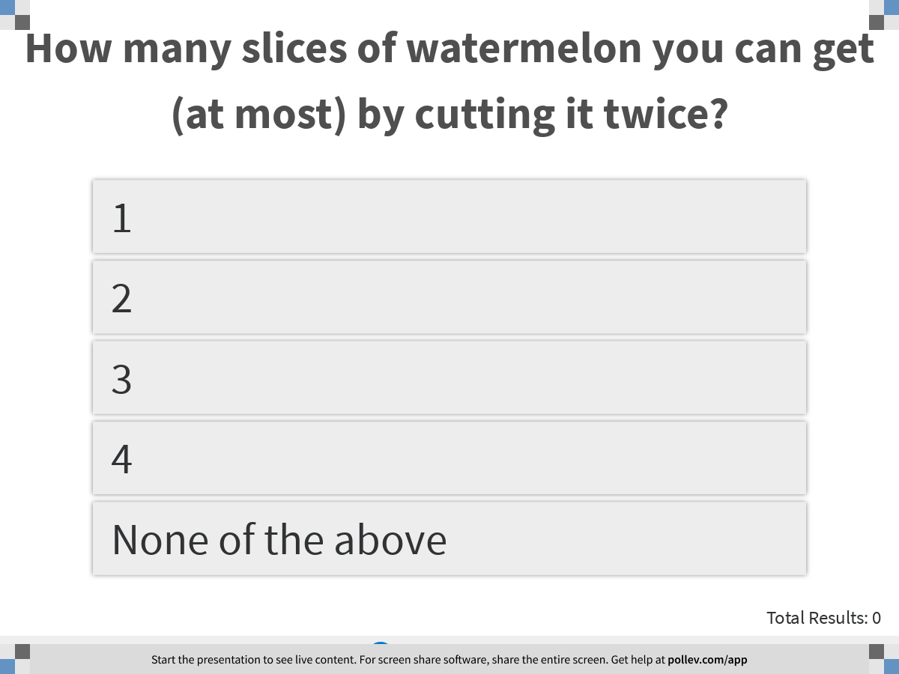
Notes:
How many slices of watermelon you can get (at most) by cutting it twice?
https://www.polleverywhere.com/multiple_choice_polls/986WsbnD4uFYzrQfbJkzu?display_state=instructions&controls=none&onscreen=persist

Slide 32
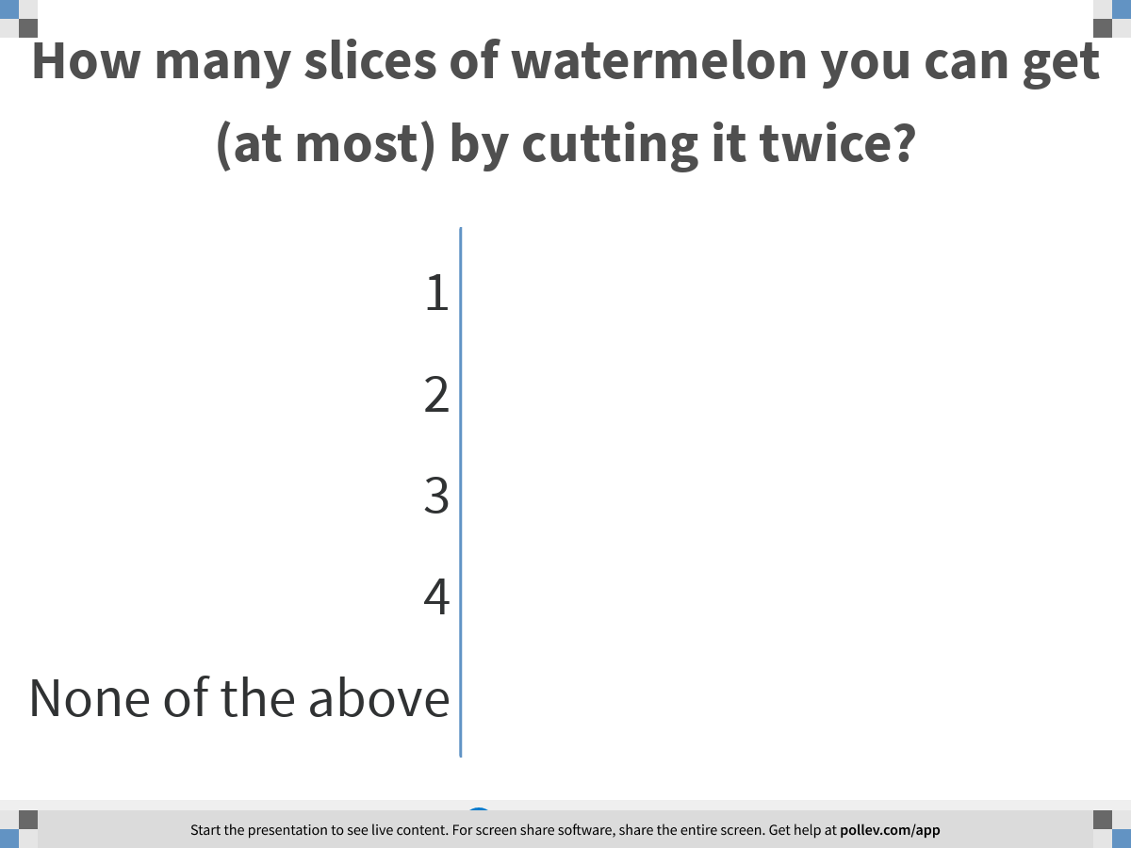
Notes:
How many slices of watermelon you can get (at most) by cutting it twice?
https://www.polleverywhere.com/multiple_choice_polls/986WsbnD4uFYzrQfbJkzu?display_state=chart&display=correctness&controls=none&onscreen=persist

Slide 33
Notes:
All about Cutting Watermelons
https://www.polleverywhere.com/competitions/ykFTT03M9fL9O9u033QSD?display_state=leaderboard&onscreen=persist

Slide 34
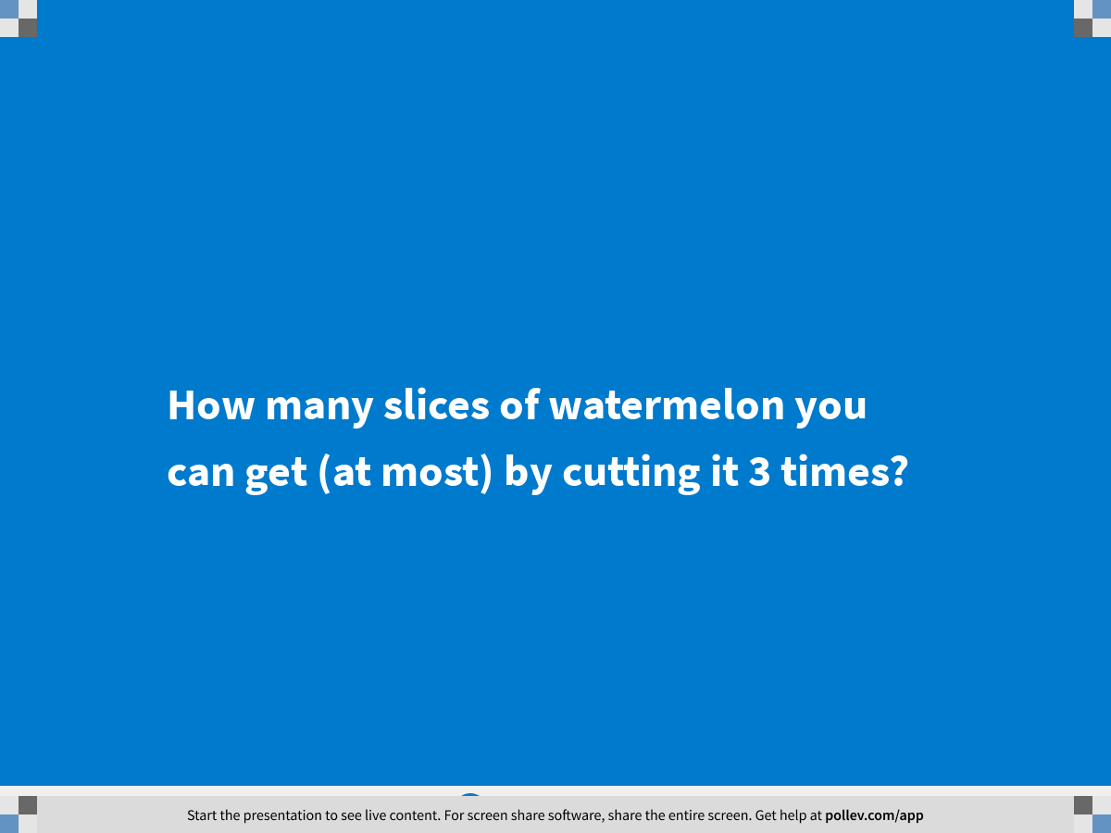
Notes:
How many slices of watermelon you can get (at most) by cutting it 3 times?
https://www.polleverywhere.com/multiple_choice_polls/J5ebw3CRjQoWAZ69oKati?display_state=title&controls=none&onscreen=persist

Slide 35
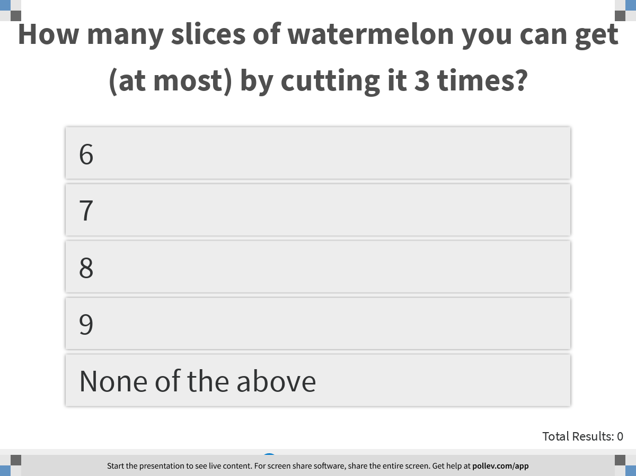
Notes:
How many slices of watermelon you can get (at most) by cutting it 3 times?
https://www.polleverywhere.com/multiple_choice_polls/J5ebw3CRjQoWAZ69oKati?display_state=instructions&controls=none&onscreen=persist

Slide 36
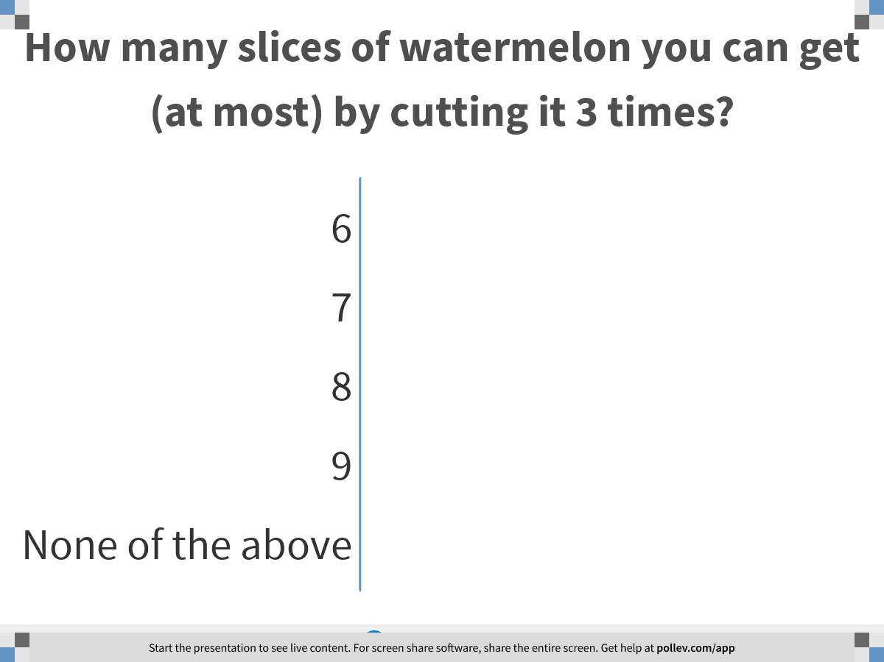
Notes:
How many slices of watermelon you can get (at most) by cutting it 3 times?
https://www.polleverywhere.com/multiple_choice_polls/J5ebw3CRjQoWAZ69oKati?display_state=chart&display=correctness&controls=none&onscreen=persist

Slide 37
Notes:
All about Cutting Watermelons
https://www.polleverywhere.com/competitions/ykFTT03M9fL9O9u033QSD?display_state=leaderboard&onscreen=persist

Slide 38

Notes:
How many slices of watermelon you can get (at most) by cutting it 4 times?
https://www.polleverywhere.com/multiple_choice_polls/bVBn72CRzE9SMfb5a2ODD?display_state=title&controls=none&onscreen=persist

Slide 39
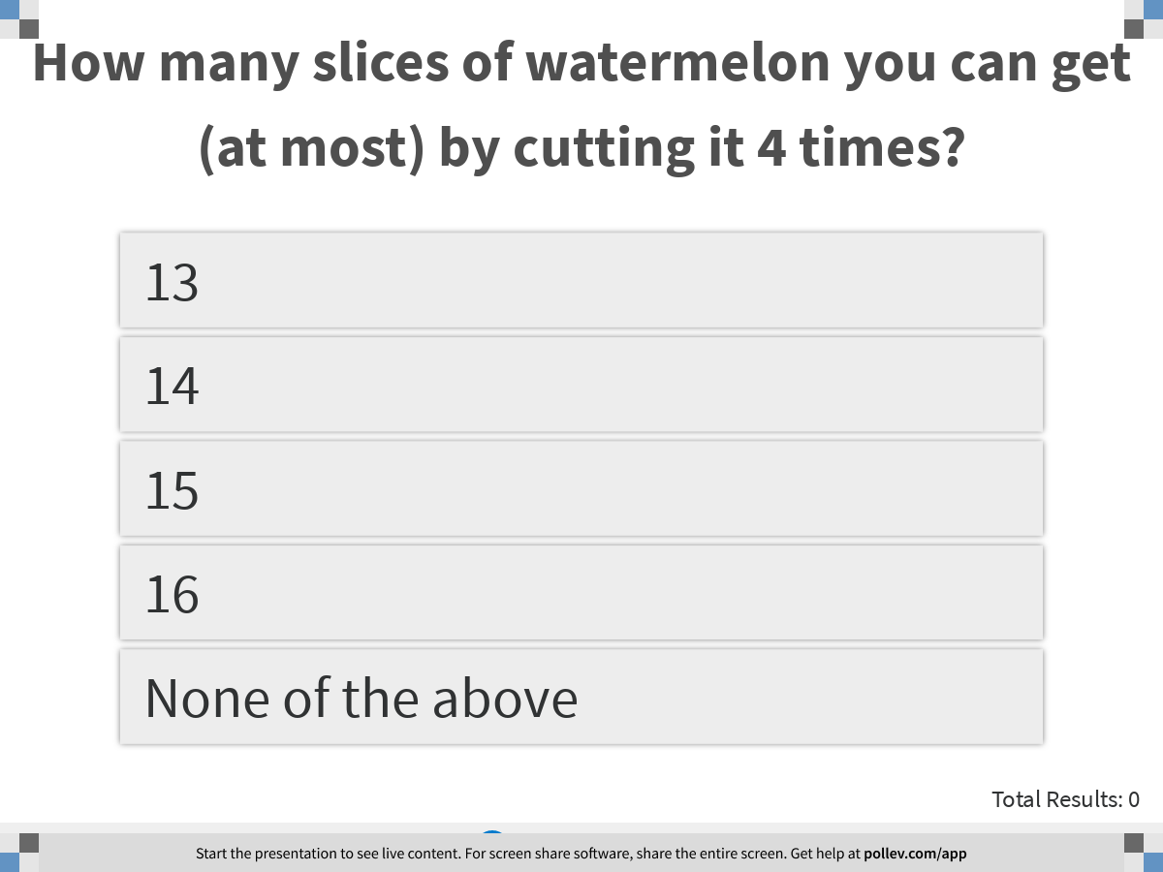
Notes:
How many slices of watermelon you can get (at most) by cutting it 4 times?
https://www.polleverywhere.com/multiple_choice_polls/bVBn72CRzE9SMfb5a2ODD?display_state=instructions&controls=none&onscreen=persist

Slide 40
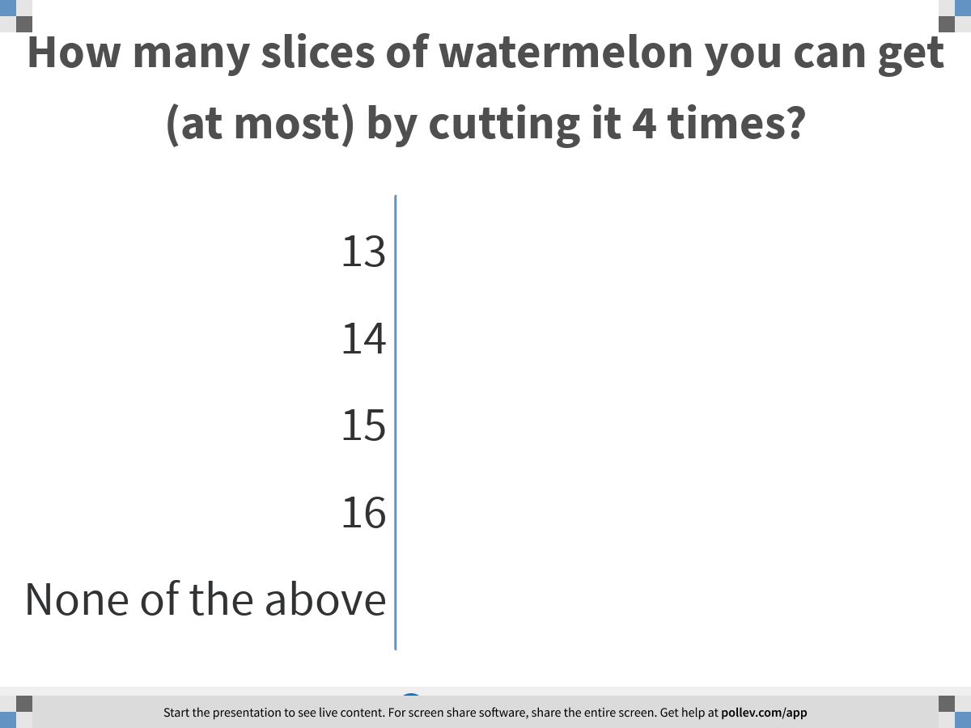
Notes:
How many slices of watermelon you can get (at most) by cutting it 4 times?
https://www.polleverywhere.com/multiple_choice_polls/bVBn72CRzE9SMfb5a2ODD?display_state=chart&display=correctness&controls=none&onscreen=persist

Slide 41
Notes:
All about Cutting Watermelons
https://www.polleverywhere.com/competitions/ykFTT03M9fL9O9u033QSD?display_state=leaderboard&onscreen=persist

Slide 42
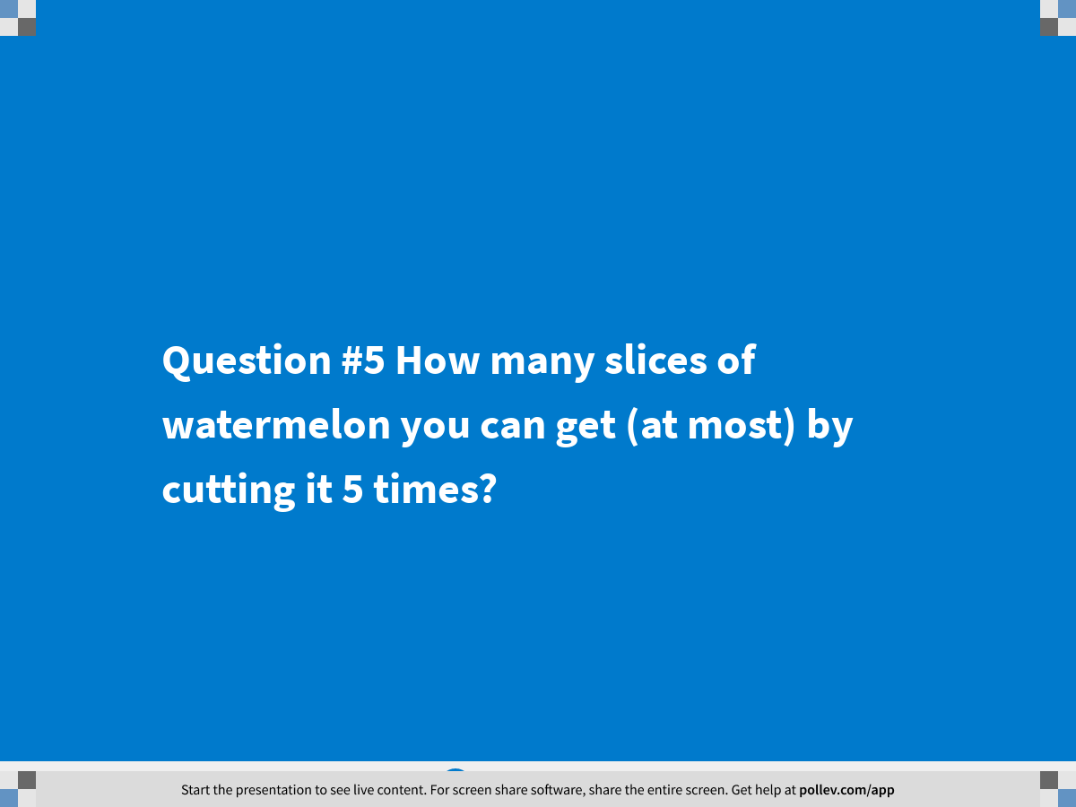
Notes:
Question #5 How many slices of watermelon you can get (at most) by cutting it 5 times?
https://www.polleverywhere.com/multiple_choice_polls/S0hffj8QAYeaZRgG0mpqT?display_state=title&controls=none&onscreen=persist

Slide 43
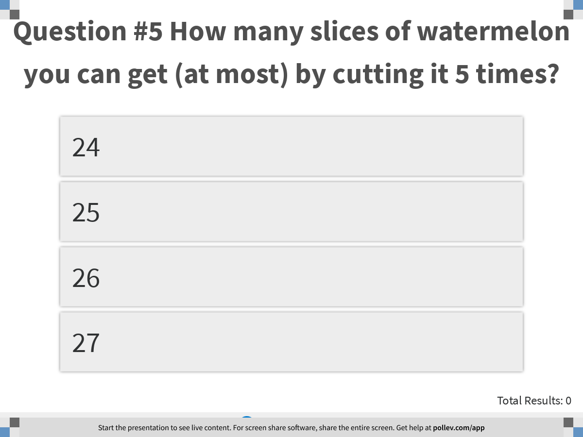
Notes:
Question #5 How many slices of watermelon you can get (at most) by cutting it 5 times?
https://www.polleverywhere.com/multiple_choice_polls/S0hffj8QAYeaZRgG0mpqT?display_state=instructions&controls=none&onscreen=persist

Slide 44
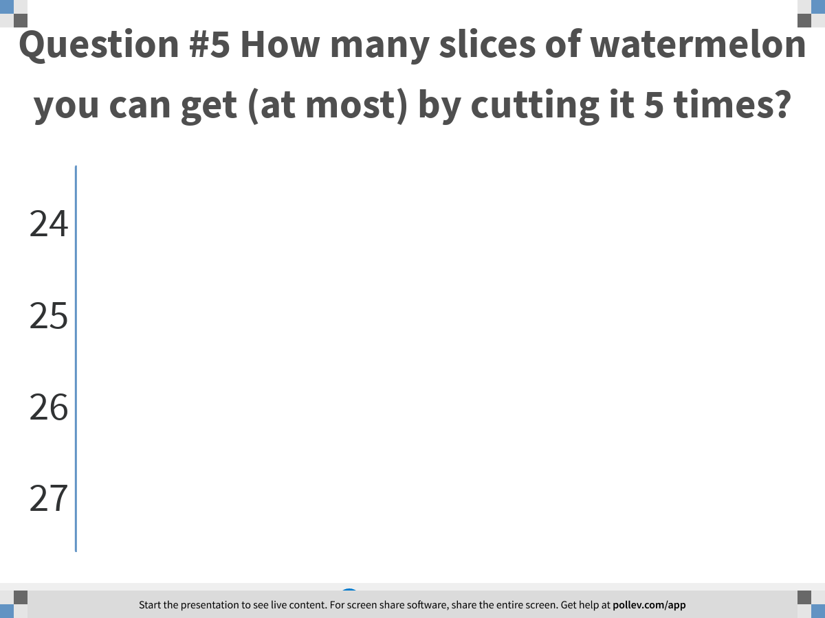
Notes:
Question #5 How many slices of watermelon you can get (at most) by cutting it 5 times?
https://www.polleverywhere.com/multiple_choice_polls/S0hffj8QAYeaZRgG0mpqT?display_state=chart&display=correctness&controls=none&onscreen=persist

Slide 45
Notes:
All about Cutting Watermelons
https://www.polleverywhere.com/competitions/ykFTT03M9fL9O9u033QSD?display_state=finale&onscreen=persist

Slide 46

Training: Problem Solving

Slide 47

Hokusai’s The Wave (c. 1829–1833)

Slide 48

Math in Art

Slide 49
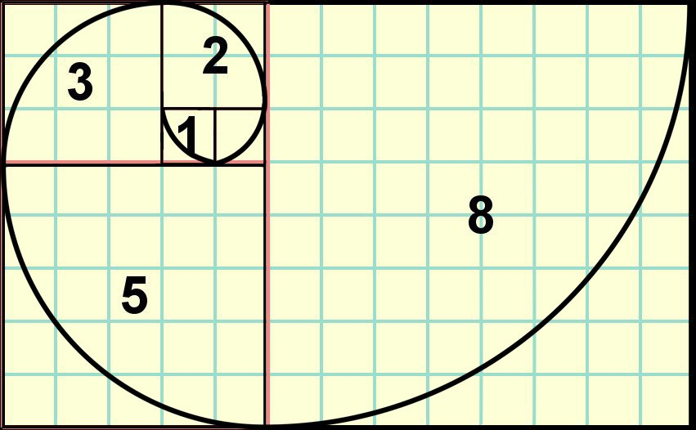
A Closer Look

Slide 50
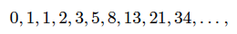
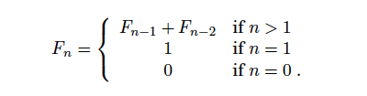
The Fibonacci Sequence

Slide 51
Today’s Problem: Compute n-th Fibonacci Number
Input: n
Output: the n-th Fibonacci Number

Slide 52
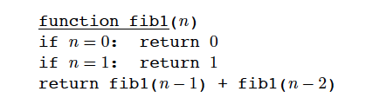
Attempt 1

Slide 53
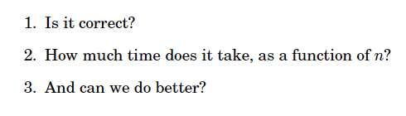
Three Questions For Algorithms (算法灵魂的三大拷问)

Slide 54
Is It Correct?

Slide 55
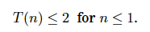
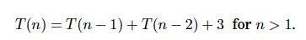
How Much Time Does it Take?
T(n): # of computer steps to compute fib1(n)
Exponential in n

Slide 56
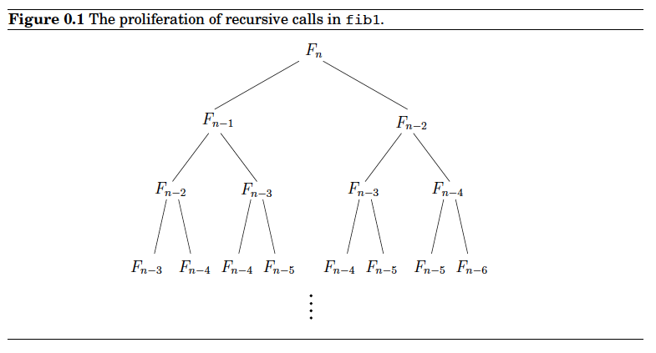
Can We Do Better?
many computations are repeated
store the intermediate results

Slide 57
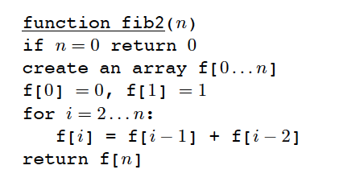
Attempt 2

Slide 58
Is It Correct?

Slide 59
How Much Time Does it Take?
Linear in n

Slide 60
Can We Even Do better?
Indeed, we can. See Assignment 1.

Slide 61

Cool Down

Slide 62
Some Take-Away Messages
Three questions for algorithms (算法灵魂的三大拷问)
The master teaches the trade, but the perfection of the apprentice’s skill depends on his own efforts
(师傅领进门，修行在个人)
We hope all of you will enjoy this course.
We are here to help. We also need your help.

